Slide 1

MAKING SENSE OF THE FUTURE
Making sense
of the Future
A workshop for future-competent students
OPEN EDUCATIONAL RESOURCE (OER)
Creative Commons Attribution 4.0 Licence
Notes:
Dear Teachers,
Below you will find a proposal for a three-part workshop that you can conduct with your students on a project day or divided into several class hours. After conducting it ourselves, we recommend the workshop for classes from secondary level I onwards. The presentation and associated materials are Open Educational Resources (OERs) released under the Creative Commons Attribution 4.0 License, so you face minimal restrictions on use and modification.
You are allowed to:
Share — replicate and distribute the material in any format or medium, for any purpose, even commercially.
Adapt — remix, modify, and build upon the material, for any purpose, even commercially.
The only condition is attribution to the Alexander von Humboldt Institute (HIIG) and inclusion of a link to the license (already provided above in this paragraph), along with verbal and written acknowledgment of any modifications made before dissemination. These attributions can be made in any reasonable manner.
This presentation and its associated OERs can be found on the HIIG website. It is part of the "Making Sense of the Future" toolkit created by HIIG on behalf of the Federal Agency for Civic Education (bpb).
Additional notes and links to support you in conducting the workshop can be found in the notes section under each slide.
Thank you for your efforts in fostering future-competence among your students. If you have any comments, questions, or practical suggestions regarding the materials, we welcome your feedback at info@hiig.de.

Slide 2
MAKING SENSE OF THE FUTURE
“The future is a much better guide to the present
than the past. Be prepared, be ready to trade
everything you know about history [...]
for a single glimpse of its future.”¹
— Kodwo Eshun (*1998),
British writer, in a futuristic novel
OPEN EDUCATIONAL RESOURCE (OER)
Creative Commons Attribution 4.0 Licence
Notes:
1 Eshun, K. (1988). More Brilliant Than The Sun. Quartet Books, London. https://monoskop.org/images/b/b2/Eshun_Kodwo_More_Brilliant_Than_the_Sun_Adventures_in_Sonic_Fiction.pdf (Last access 02/2024).
You can welcome your students with this quote from the British writer Kodwo Eshun and set the tone for the day. Encourage your students to brainstorm why it might be important to engage with the future and announce that today they will be exploring future thinking together. Emphasise that these ideas will be collectively reflected upon and contextualised at the end of the workshop.
Eshun is known for his work in the field of "Afrofuturism." The experimental-futuristic novel from which the quote originates is freely available in English (see the citation above); however, it may be too challenging for middle school students.

Slide 3
Agenda for today our Futures
All together: “Answer by moving“ (20 minutes)
“Megatrend“ – What’s that? (15 minutes)
Explore “Signals of change“ (3 x 10 minutes)
B R E A K
All together: “Newspaper from 2040“ (1.5 hours)
Reflection (15 minutes)
Agenda
MAKING SENSE OF THE FUTURE
Notes:
Give your students an overview of the upcoming workshop. The break times can be customised -however, short or longer breaks between the individual exercises are important.

Slide 4
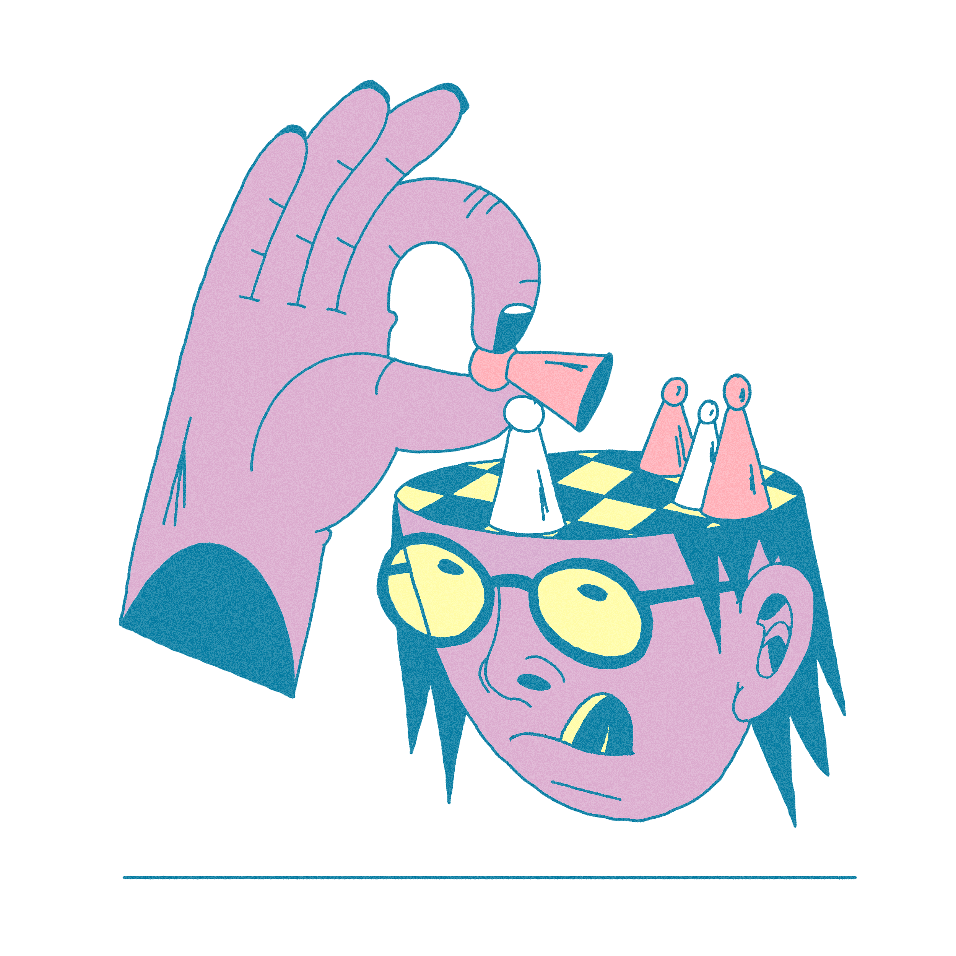
MAKING SENSE OF THE FUTURE
Answer by
moving
Show your stance and impact towards digital futures!
20 minutes
Creative Commons Attribution 4.0 Licence
ALEXANDER VON HUMBOLDT INSTITUT FÜR INTERNET UND GESELLSCHAFT · hiig.de
Notes:
The exercise "Answer by moving" can be found in its non-didactic form on the HIIG website.
It is based on the "Polak Game" by futurist Fred Polak. For those interested, you can learn more about his work in this article from the Journal of Future Studies: Polak Game EN. Candy, S. & Hayward, P. (2017). The Polak Game, Or: Where Do You Stand? Journal of Futures Studies. https://jfsdigital.org/articles-andessays/2017-2/the-polak-game-or-where-do-you-stand (Accessed: 02/2024).
Preparation for you as the teacher: A line of opinion with two axis will be taped on the floor of the classroom. At the ends of each axis, you can attach paper with the sentences: "Digitalisation makes the world a better place" and "Digitalisation makes the world a worse place" on one wall. At the end of the other axis, the sentences "My ability to act is diminished by digitalisation. I can’t influence things" and "My ability to act is increased by digitalisation. I can influence things." are placed.

Slide 5
Answer by moving
Digitalisation is changing the futures
of our societies.
Processes of change in the world resulting from the use of computers and the internet.²
Plural, because there is not only one future, but numerous futures are conceivable.³
Intro
MAKING SENSE OF THE FUTURE
Notes:
2 WDR Kinderseiten, Lexikon, Digitalisierung. https://kinder.wdr.de/tv/neuneinhalb/neuneinhalb-lexikon/lexikon/d/lexikon-digitalisierung100.html (Accessed: 2/2024). 3 Popp, R. (2012). Zukunftsforschung auf dem Prüfstand. Zukunft und Wissenschaft: Wege und Irrwege der Zukunftsforschung, 93.
First Step: You can confront your students with the statement “Digitalisation is changing the futures of our societies" and ask them what this statement could mean. Together, explain the terms "digitalisation" and the plural "futures" as suggested above.
Note: This slide contains animations, so the definitions appear only after further mouse clicks. This allows students to first think about their own definitions.

Slide 6


Answer by moving
Task: You have one minute to quietly reflect on:
In the year 2040, how will digitalisation have changed
the education system and our schools,
democracy and its processes
(elections, protests, freedom of speech, ...), or
the climate crisis?
Pay special attention to your feeling:
Does it feel positive or negative to think about this?
One minute
Individual work
Notes:
Second Step: Ask your students to reflect individually and quietly on whether they have a positive or negative feeling when thinking about the question above. It is important here that students initially consider this on their own and do not yet discuss with each other, so that later, a more productive discussion can take place using the opinion line methodology.

Slide 7

Answer by moving
Digitalisation makes the world
a better place
Task:
Imagine yourself in a generation in the future,
in the year 2040. Do you think the world will be a better place thanks to digitalisation than the one we live in today - or do you imagine it will be a worse place?
Position yourself along the opinion line.
Digitalisation makes the world
a worse place
One minute
All together
Notes:
Third Step: Ask your students to line up along the first axis of the opinion line. Emphasise that there is no right or wrong answer. Once all students have settled in a fixed position, ask them to look around from where they stand, and summarise for your students whether the class represents a wide range of positions, is it rather polarised, or if the majority tends towards a particular position.

Slide 8
Answer by moving
Task:
Imagine yourself in a generation in the future,
in the year 2040.
How do you see your personal agency in the digital world and your potential to influence social processes?
Position yourself along the opinion line.
Digitalisation makes the world
a better place
My ability to act is diminished by digitalisation.
I can’t influence things.
My ability to act is increased by digitalisation.
I can influence things.
Digitalisation makes the world
a worse place
One minute
All together
Notes:
Fourth step: Now ask your students to move along the second axis and assess their personal ability to act in the digitalised future. Then summarise again for your class the extent to which the opinions are dispersed/polarised/homogeneous.

Slide 9
Answer by moving
Task:
Find a partner who stands as far away from you as possible.
Ask each other the following questions:
Why are you standing where you are?
Which aspect of the digital future have you thought about?
What exactly makes you optimistic/pessimistic?
What would it take for you to move further towards the optimistic side?
Can you understand why I positioned myself this way?
5 minutes
Work in pairs
Notes:
Fifth Step: Now ask the students to find a partner with a contrasting, or at least not identical, opinion and discuss the questions listed above in one area of the room. At the end of the 5-minute partner work session, you can ask some pairs to summarise their discussion experiences in the plenum.

Slide 10

MAKING SENSE OF THE FUTURE
Megatrends
Exploring signals
of change
45 minutes
Creative Commons Attribution 4.0 Licence
Notes:
The exercise "From Weak Signals to Megatrends" can be found in its non-didactic form on the HIIG website.
Discussing the distinction between "Weak Signals" was omitted for reasons of didactic reduction and workshop focus for students.
Further information on Megatrends can be found on the website of the Zukunftsinstitut (including a Megatrend map) and the futurologist Karlheinz Steinmüller.
Preparation for you as the teacher:
Read the HIIG website for the basic definition of Megatrends. As a specification of the exercise specifically for middle school students, the three Megatrends "Climate Change," "Global Networking," and "Overcoming Gender Stereotypes" have been selected. You don't need to provide extensive input on these Megatrends. Instead, the bullet points on the upcoming slides can be used to gather and consolidate students' general knowledge about the effects of the trends on society. The key point is: it's about students practicing thinking about the future and future scenarios for society despite incomplete knowledge and unknown variables.
Print pages 8-10 of the Megatrends exercise three times on A3 paper and cut along the pre-printed cutting lines. Distribute the worksheets to three group tables and add the term "Climate Change" to the "Your Signal" worksheet at the first group table, "Global Networking" at the second group table, and "Overcoming Gender Stereotypes" at the third table.

Slide 11
Megatrends
Megatrends =
slow, global, but far-reaching transformation processes that significantly influence economics, politics, ecology, mobility, and society.⁴
Intro
MAKING SENSE OF THE FUTURE
Notes:
4 Piepenbrink, J. (2015). „Megatrends?”. Aus Politik und Zeitgeschichte. Beilage zur Wochenzeitung Das Parlament, 31, 32, 1-5. https://www.bpb.de/shop/zeitschriften/apuz/209952/editorial/ (Accessed: 2/2024).

Slide 12
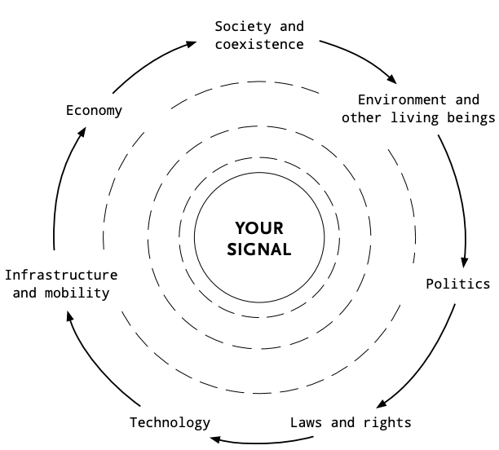
Megatrends
Characteristics (exemplary):
Rising sea levels and natural disasters
Desertification
Depletion of resources
Climate change
Intro
MAKING SENSE OF THE FUTURE
Notes:
First Step: Explain to the students that one globally recognised megatrend is climate change. Using the graphic, explain which societal areas megatrends have an influence on. Then briefly assess the students' knowledge about the characteristics of climate change based on the example features. Emphasise that within this framework, there is no claim to completeness.
If you are interested in climate-sensitive education and workshops on climate change for middle school level, you can find numerous Open Educational Resources at projects like KlimaChallenges.

Slide 13
Megatrends
Characteristics (exemplary):
International trade
Information society
Cooperation between states
Globalisation
Intro
MAKING SENSE OF THE FUTURE
Notes:
Second Step: Explain that another globally recognised megatrend is the advancing global networking or globalisation. Gather in the plenum the students' knowledge about the characteristics of this trend based on the bullet points above.

Slide 14
Megatrends
Characteristics (exemplary):
A more free, more pluralistic society
Increasing labour force participation through emancipation
Demographic change
(in Germany: 1960: 2.3 children per woman 2024: 1.4 children per woman)⁵
Overcoming gender stereotypes
Intro
Intro
MAKING SENSE OF THE FUTURE
MAKING SENSE OF THE FUTURE
Notes:
5 Statistisches Bundesamt: Geburten. https://www.destatis.de/DE/Themen/Gesellschaft-Umwelt/Bevoelkerung/Geburten/_inhalt.html#sprg575064 (Zugriff 02/2024).
Third step: Explain that another globally recognised megatrend is the overcoming of gender stereotypes. In plenary, collect information on the characteristics of this trend based on the key points above.

Slide 15
Megatrends
Task:
Get together in three groups. Each group works at one table for 10 minutes and then switches.
At the group tables, you will find the graph on the left which enlists aspects of society that will be affected by the three megatrends (climate change, global networking and overcoming gender stereotypes).
On the respective worksheets, write down your ideas in bullet points on how the megatrend will affect the aspect of society in the future. Add to the ideas of the other groups.
Megatrend
3 x 10 minutes
Three groups
Notes:
Fourth step: Now set up three large group tables together and distribute the previously printed materials (can be found on page 7 here). Decide which table will be assigned to work on which megatrend. Keep an eye on the time and let your students know after 10 and 20 minutes that it is time to change tables. At the end of this exercise, the group sitting at the respective table can summarise for the classroom "how the megatrend will affect various areas of society in the future".

Slide 16
Agenda for today our Futures
B R E A K
then …
All together: “Newspaper from 2040“ (1.5 hours)
Reflection (15 minutes)
Agenda
MAKING SENSE OF THE FUTURE

Slide 17

MAKING SENSE OF THE FUTURE
Newspaper
from 2040
Think ahead
and write creatively
1.5 hours
Creative Commons Attribution 4.0 Licence
Notes:
The exercise "News from 2040" can be found in a non-didacticism version on the HIIG website.
Preparation for you as a teacher: Find out from the German teacher of your class what the level of competence of the class is with regard to writing their own newspaper articles. Regardless of the level, it is advisable to allow the students to work with digital devices and the internet for this task. If your students have difficulties writing their own articles, for example because you teach at a school in a challenging environment or in a class with varying language skills, the students can carry out this unit of the workshop with the help of artificial intelligence such as "SchulKI". How you can work with SchulKI in the classroom without much preparation is explained here.

Slide 18
Newspaper from 2040
Our classroom is now a newspaper editorial office
in the year 2040.
We ask ourselves:
What will everyday life look like in the future?
What news from different areas of society will we read?
Our goal: Writing the news of the day for February 4th, 2040.
Intro
MAKING SENSE OF THE FUTURE
Notes:
First step: Explain to your class that they are now together in the year 2040 and are setting up a joint newspaper editorial team.

Slide 19
Newspaper from 2040
Newspapers have different “editorial teams”. These are groups of journalists who are responsible for a specific “department” (subject area).
For example, our editorial office could have the following “editorial teams”:
Economy
Mobility
Fashion & Lifestyle
Technology
Politics
Law & Governance
Environment
Intro
MAKING SENSE OF THE FUTURE
MAKING SENSE OF THE FUTURE
Notes:
Second step: Explain to your class what editorial offices and departments are and clarify which topics would be suitable for the departments mentioned as examples.

Slide 20
Newspaper from 2040
Task:
Join one of the following editorial teams. There should be roughly the same number of journalists working in all of the teams.
Economy
Mobility
Fashion & Lifestyle
Technology
Politics
Law & Governance
Environment
You now have one hour to write newspaper articles on various topics from your department. Discuss your topic ideas in the editorial teams and then decide which journalist is responsible for which article.
1 hour
In small groups
Notes:
Third step: Form "editorial teams" together with your students, depending on their area of interest. Use group tables or group rooms to create an environment conducive to group work in which the editorial teams can come together. Help your students to collect ideas together and encourage them to have free rein over their ideas. Emphasise that their work cannot be graded negatively.

Slide 21
Newspaper from 2040
Requirements for the articles:
Headline
Introduction answers the “W-questions”:
  What happened?
  When did it happen?
  Where did it happen?
  Why did it happen?
  Who was involved?
Total length: Approximately one page
Written in past tense
No personal judgements;
neutral language
There are no limits to your imagination!
1 hour
In small groups
Notes:
Fourth step: Discuss the guidelines for the newspaper articles with your students. You can also print out these guidelines for the individual editorial teams.

Slide 22
Newspaper from 2040
Thursday, February 4th, 2040
Present your news of the day!
Economy
Mobility
Fashion & Lifestyle
Technology
Politics
Law & Governance
Environment
Presentation of results
MAKING SENSE OF THE FUTURE
Notes:
Fifth step: Have the students' newspaper articles sent to you / handed in and summarise them in a document as a newspaper. If you can, also use image-generating artificial intelligence to generate images for the respective articles (more information here, for example). The students can now present their articles or their headlines in short form.
Did your students produce great results during the workshop? Let us know at info@hiig.de

Slide 23

Final reflections
“Anticipating the future is a skill that needs to be learnt and practised just like reading and writing.“⁶
“The future is a much better guide to the present than the past”⁷
15 minutes
MAKING SENSE OF THE FUTURE
Notes:
6 Alexander von Humboldt Institut für Internet und Gesellschaft. Making sense of the Future. https://www.hiig.de/making-sense-of-the-future/ (Access 02/2024).
7 Eshun, K. (1988). More Brilliant Than The Sun. Quartet Books, London.
At the end of the workshop, you can discuss the two quotes above in plenary and remind them of the start of the workshop. Ask your students what their thoughts are on future thinking and what importance this can have for their lives and the organisation of our society.

