Slide 1
Format Production and Protection: Recent Market Trends
Reforming Formats Workshop / Keynote
Prof Dr Susanne Stürmer
December 5th, 2013

Slide 2




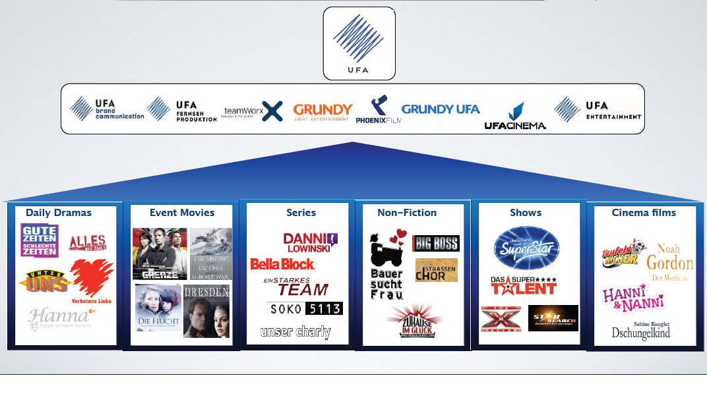
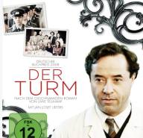
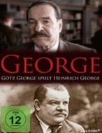
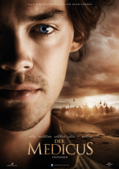
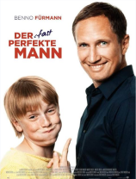

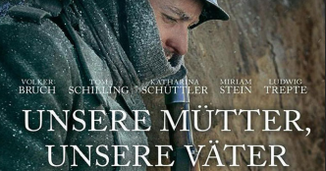
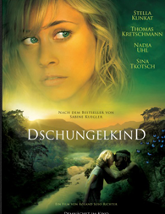
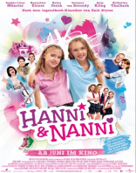

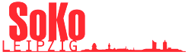
15.12.2013
2
Die UFA in der digitalen Medienrealität

Slide 3
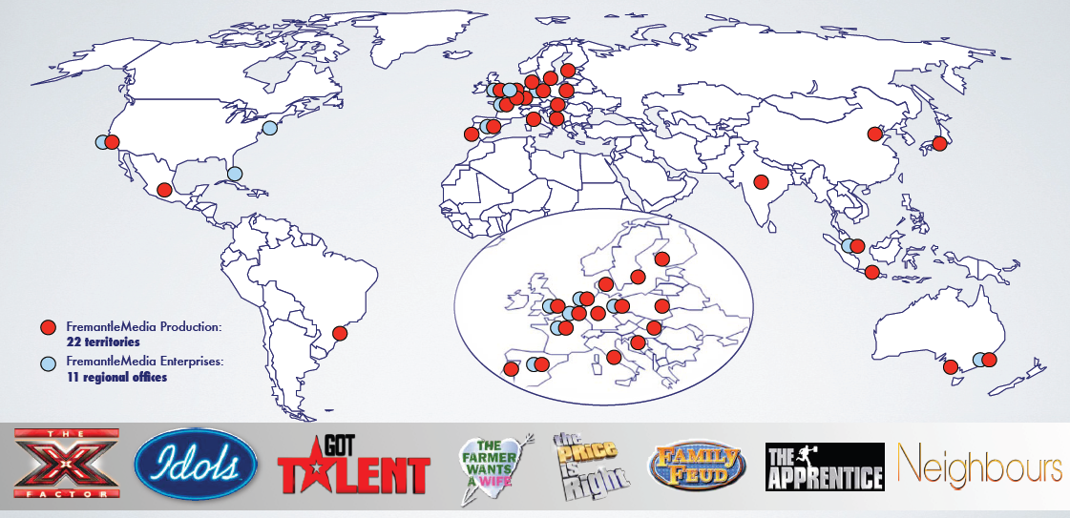

FremantleMedia worldwide network
Notes:
Dies ebenfalls aktueller (hier ist noch FME drauf!)

Slide 4

HFF Konrad Wolf
The Film School Hochschule für Film und Fernsehen Konrad Wolf was founded in 1954.
Oldest, yet at the same time one of the most modern and largest film academies in Germany
Located as an integral part of the Potsdam-Babelsberg media centre, which is unique in Europe
10 BA courses and currently 4 MA programmes with more MA courses to follow in autumn 2014
Currently 560 students
Dedicated to the entire spectrum of moving image media
Unique approach of combining artistic freedom and theory-based methodology with industry requirements and the acquisition of manual and technical skills involving state-of-the-art media technology
Notes:
Füge ich später dazu.

Slide 5
Overview
Format business & protection
Market data &
Recent local trends
Relevant drivers:
  Rights ownership
  International investment strategies
  Digitalization?

Slide 6
TV formats: general issues
Format definition
  an idea to do a programme within a genre – a quiz show, a gardening show, etc
  fleshed out with a structure comprising elements which individually may not be unique or even original, but as assembled do form something distinctive
Issues in effective format protection
  Can formats attract copyright protection?
  Has copying taken place?
  Are formats considered to be alike?
  Etc.

Slide 7
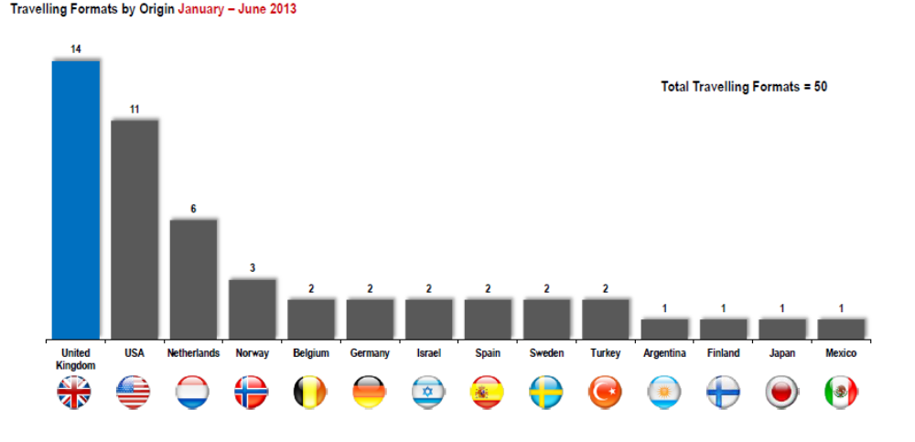
Travelling Formats by originating Country

Slide 8
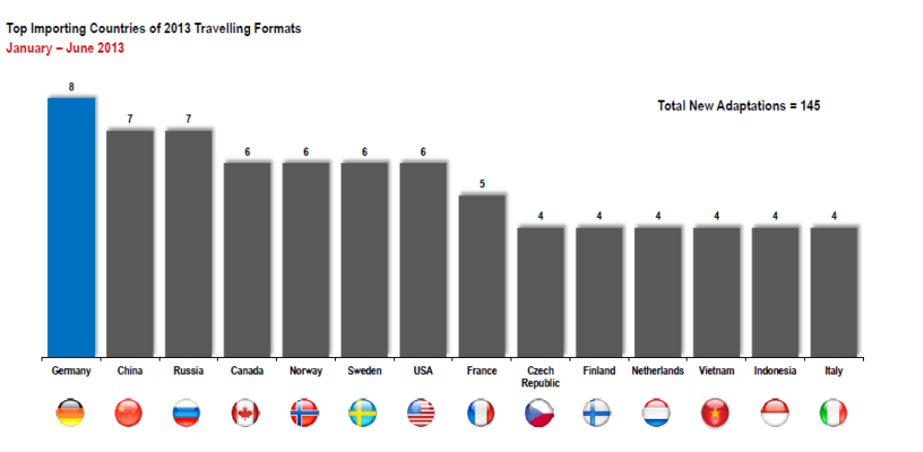
Germany as biggest importer of formats

Slide 9
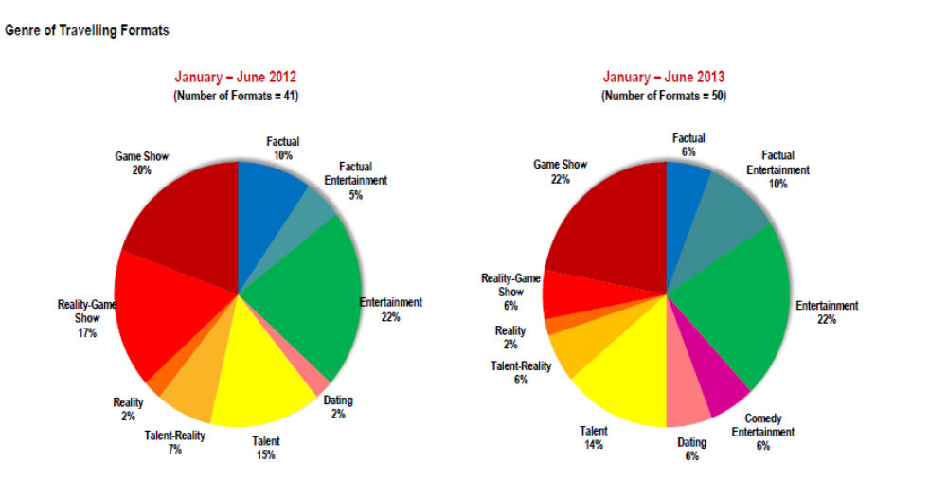
Genre mix 2012/13

Slide 10
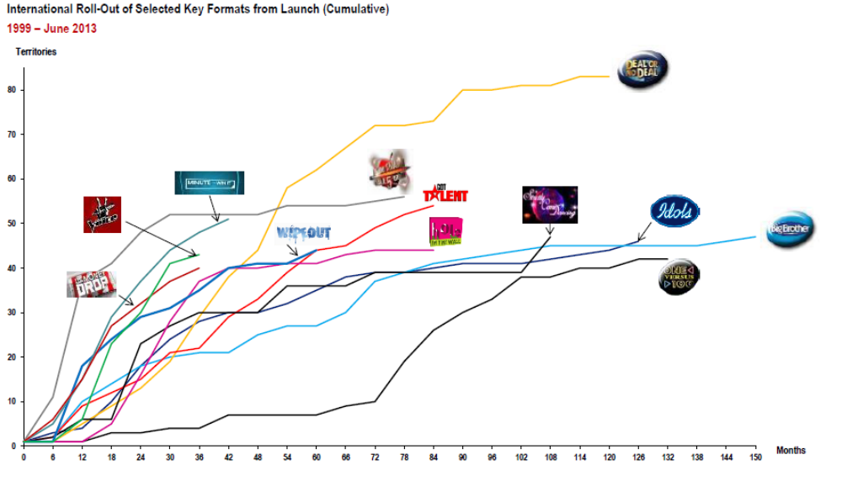
Speed and Pattern of Role Out (1)

Slide 11
Overview
Format business & protection
Market data &
Recent local trends
Relevant drivers:
  Rights ownership
  International investment strategies
  Digitalization?

Slide 12
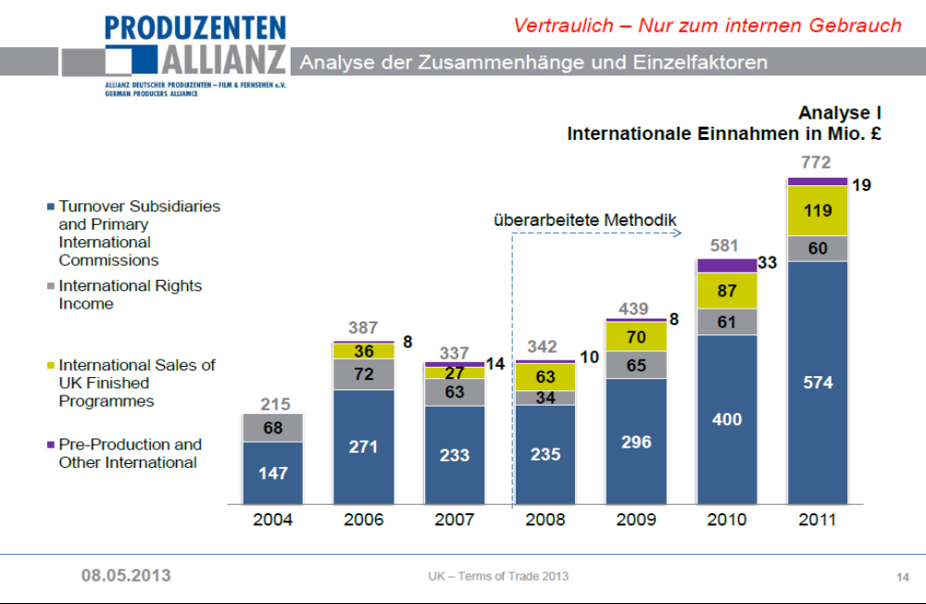
Rights Ownership as driver: UK example

Slide 13
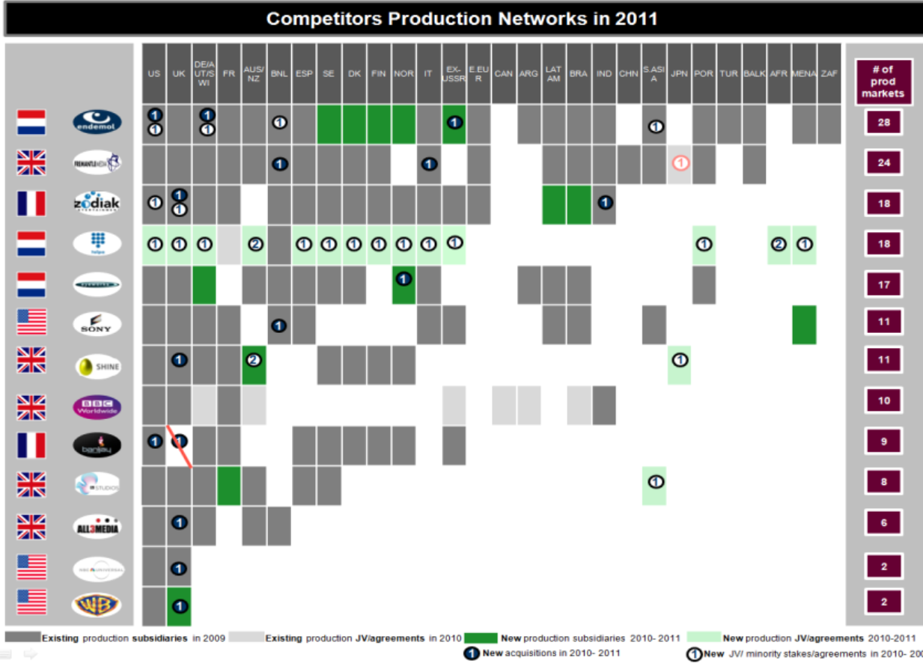
Ownership follows rights

Slide 14
Does digitalisation influence format business
Higher demand for unique programme?
Higher danger of format violation?
Revival of Scripted
Fragmentation requires highly targeted (small budget) programme
Digital can support development / reduce development risk
Digital increases refinancing possibilities
YouTube star driven, not content driven

